Slide 1


Day 2
GirlScript Jamshedpur

Slide 2
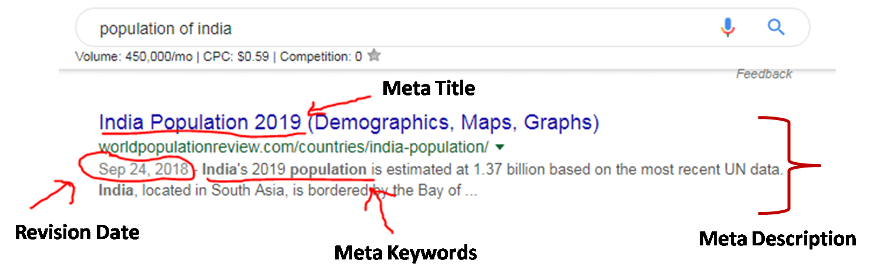
HTML <meta> Tag
The <meta> tag defines metadata about an HTML document. We use <meta> tag inside the <head> tag. All the elements and data inside the <meta> tag are not visible on the webpage.
Attributes: name, charset,content, http-equiv
Eg.
<head>
<meta name="keywords" content="HTML, CSS, JavaScript">
<meta name="description" content="Free Web tutorials for HTML and CSS">
<meta name="author" content="John Doe">
<meta http-equiv="refresh" content="30">
</head>

Slide 3
HTML <span> Tag
The HTML <span> tag is used for grouping and applying styles to inline elements. The <span> tag is an inline container used to mark up a part of a text, or a part of a document. The <span> tag is easily styled by CSS or manipulated with JavaScript using the class or id attribute.
Eg.
View: My name is Gunjan Paul
Code: <h1>my name is <span style="color: red;">Gunjan Paul</span></h1>

Slide 4
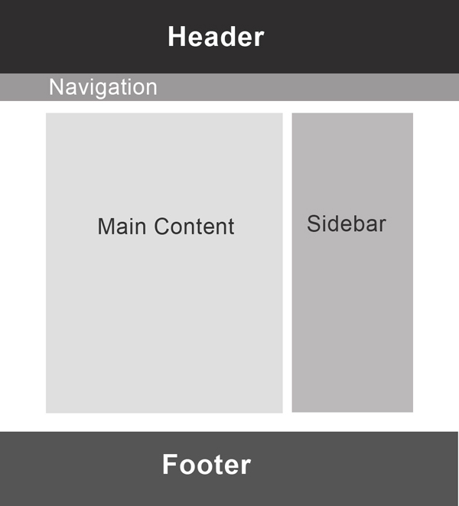
￼header-nav-footer

Slide 5
HTML <header> tag
<header> tag is the added after html5. Before html5, we used to use <div class=”header”>
The HTML <header> element represents introductory content, typically a group of introductory or navigational aids. It may contain some heading elements but also a logo, a search form, an author name, and other elements.
So eg.
<article>
<header>
<h2>The Planet Earth</h2>
<p>Posted on Wednesday, <time datetime="2017-10-04">4 October 2017</time> by Jane Smith</p>
</header>
<p>We live on a planet that's blue and green, with so many things still unseen.</p>
<p><a href="https://janesmith.com/the-planet-earth/">Continue reading....</a></p>
</article>

Slide 6
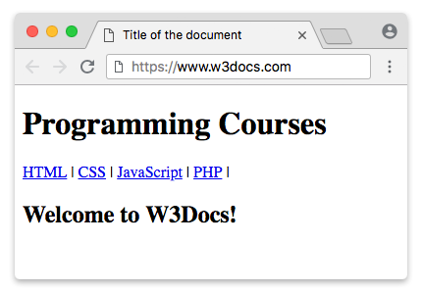
HTML <nav> tag
HTML <nav> tag is used to represent a section which contains navigation links, either within current document or to another document.
<article>
<h1>programming course</h1>
<nav>
<a href="">HTML</a>
<a href="">CSS</a>
<a href="">JAVASCRIPT</a>
<a href="">PHP</a>
</nav>
<h1>Welcome to W3School</h1>
</article>

Slide 7

HTML <footer> tag
The <footer> tag in HTML is used to define a footer of HTML document. This section contains the footer information (author information, copyright information, carriers, etc).
The footer tag comes inside the body tag.
Eg.

Slide 8
Html <hr> tag
The HTML <hr> tag is used for creating a horizontal line. This is also called Horizontal Rule in HTML.
<h1>My first section</h1>
<p>my contact details</p>
<hr>
<p>my address</p>

Slide 9
Html <img> tag
The <img> tag is used to insert an image into an HTML document. The image itself isn’t inserted directly into the document, the browser inserts an HTML image from the source specified in the <img> tag.
Syntax <img src="img_girl.jpg" alt="Girl in a jacket">
Src: the source of the image, it could be url or file path
Alt: alternate text for the image.

Slide 10
Html <video> tag
The HTML Video element (<video>) embeds a media player which supports video playback into the document.
Syntax <video width="320" height="240" controls>
<source src="movie.mp4" type="video/mp4">
<source src="movie.ogg" type="video/ogg">
Your browser does not support the video tag.
</video>

Slide 11
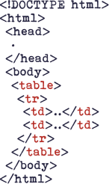
Html <table> tag
The HTML <table> tag is used for defining a table. The table tag contains other tags that define the structure of the table.
An HTML table consists of one <table> element and one or more <tr>, <th>, and <td> elements.
<tr> tag is used to create table rows
<td> tag is used to create data cells
<th> tag for defining table heading

Slide 12
HTML <INPUT> TAG
The <input> tag is used to create interactive controls within a form.
An <input> element can vary in the way it appears and the attributes it uses or requires depending on the type attribute specified.
<!DOCTYPE html>
<html>
<body>
<center>
<h1>GeeksForGeeks</h1>
<p>
The type email defines
a field for email address and
type submit defines a submit button.
</p>
<form>
<label>E-mail:</label>
<input type="email"
name="emailaddress">
<br>
<br>
<input type="submit">
</form>
</center>
</body>
</html>

Slide 13
Type attribute
button
A push button with no default behavior displaying the value of the value attribute, empty by default.
checkbox
A check box allowing single values to be selected/deselected.
file
A control that lets the user select a file. Use the accept attribute to define the types of files that the control can select.
month
A control for entering a month and year, with no time zone.
password
A single-line text field whose value is obscured. Will alert user if site is not secure.

Slide 14
Html <ol> & <ul> tag
The <ol> tag defines an ordered list and <ul> tag defines an unordered (bulleted) list.
<ol> tag
<ol>
<li>Coffee</li>
<li>Tea</li>
<li>Milk</li>
</ol>
<ul> tag
<ul>
<li>Coffee</li>
<li>Tea</li>
<li>Milk</li>
</ul>

Slide 15
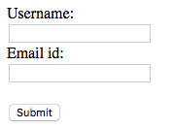
Html <form> tag
HTML Form is a document which stores information of a user on a web server using interactive controls. An HTML form contains different kind of information such as username, password, contact number, email id etc.
<!DOCTYPE html>
<html>
<body>
<form>
Username:<br>
<input type="text" name="username">
<br>
Email id:<br>
<input type="text" name="email_id">
<br><br>
<input type="submit" value="Submit">
</form>
</body>
</html>

